Slide 1

Vel Tech Rangarajan Dr. Sagunthala R&D Institute of Science and Technology
School of Computing
Department of Computer Science and Engineering
10211CS224 / FULL STACK APPLICATION DEVELOPMENT (JAVA)
PROJECT REVIEW : MILESTONE PROJECT – 1
Date: DD-MM-YYYY
Full-Stack Skill Learning Academy Marketplace with Secure Authentication
SDG : SDG 4 – Quality Education and SDG 8 – Decent Work and Economic Growth
Presented By:
NISHANTH G – VTU24506 – 23UECS1155.
Courses Handling Faculty:
Dr. K. SEETHA LAKSHMI – ASSOCIATE PROFESSOR

Slide 2
INTRODUCTION
The rapid growth of digital education has increased the demand for structured and intelligent learning platforms.
Traditional Learning Management Systems often lack personalization, automated enrollment workflows, and data-driven insights.
Manual course management and limited progress tracking reduce overall learning efficiency.
To address these challenges, this project proposes Skill Academy AI, an AI-powered Smart Learning Management System.
The system implements secure role-based access for students and instructors.
It enables structured course management, controlled enrollment approval, and real-time progress monitoring.
AI-based recommendation modules are designed to enhance personalized learning experiences.
The platform aims to improve efficiency, accessibility, and overall quality in digital education environments.
1
2
3
4
5
6
7
8
9

Slide 3
PROBLEM STATEMENT
Existing learning management systems often lack intelligent personalization and structured automation.
Manual enrollment handling and course management processes lead to inefficiencies and delays.
Many platforms do not provide real-time progress tracking and performance insights.
Students face difficulty in identifying relevant courses aligned with their interests and skill levels.
Instructors lack centralized tools to efficiently manage course approvals and analytics.
Limited integration of AI technologies reduces the effectiveness of modern digital learning environments.
There is a need for a secure, automated, and intelligent LMS to enhance learning outcomes.
Hence, an AI-powered Smart Learning Management System is proposed to address these limitations.
1
2
3
4
5
6
7
8
9

Slide 4
OBJECTIVE(S)
1
To design and develop an AI-powered Smart Learning Management System that provides secure role-based authentication, structured course management, and an automated enrollment approval workflow for students and instructors.
To implement AI-based course recommendation modules and real-time progress tracking mechanisms to enhance personalized learning, improve academic performance monitoring, and increase overall system efficiency.
2
3
4
5
6
7
8
9

Slide 5
PROPOSED SYSTEM
1. Description of the Proposed System :
The proposed system, Skill Academy AI, is an AI-powered Smart Learning Management System designed to provide structured digital education.
It includes secure role-based authentication for students and instructors.
The platform supports automated course management, enrollment request handling, and approval workflows.
AI-based recommendation modules and real-time progress tracking features are integrated to enhance personalized learning.
1
2
3
4
5
6
7
8
9

Slide 6
PROPOSED SYSTEM
2. Existing Issues Addressed :
• Manual enrollment and course approval processes cause delays and inefficiencies. • Traditional LMS platforms lack intelligent personalization and automated analytics. • Limited progress tracking reduces effective performance monitoring. • Inadequate role-based access control may lead to security and management issues.
1
2
3
4
5
3. Advantages Over Existing Systems :
• Provides automated enrollment workflows, reducing manual intervention. • Enhances learning through AI-based course recommendations. • Offers real-time progress monitoring for improved performance evaluation. • Ensures secure, structured, and efficient course management through role-based access control.
6
7
8
9

Slide 7
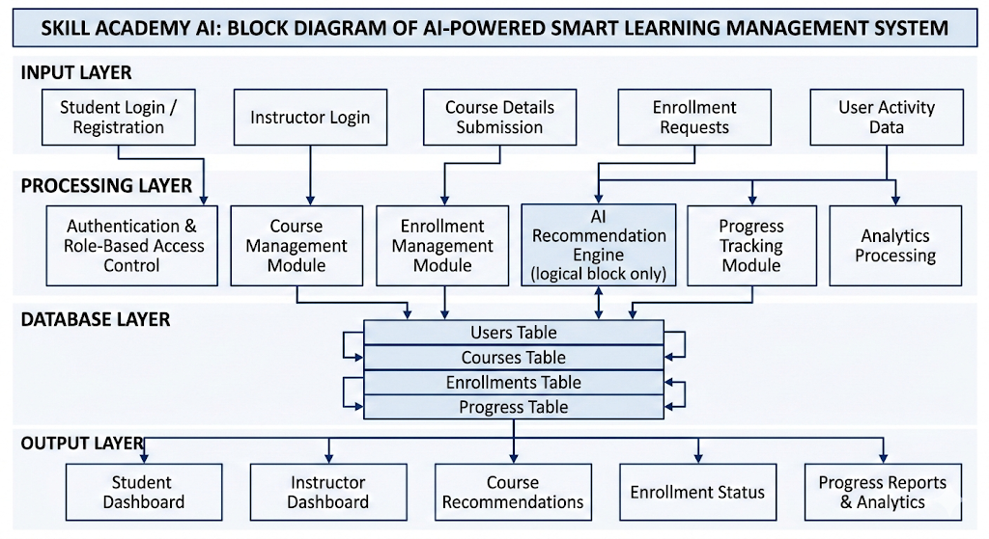
PROPOSED SYSTEM ARCHITECTURE
1
2
3
4
5
6
7
8
9

Slide 8
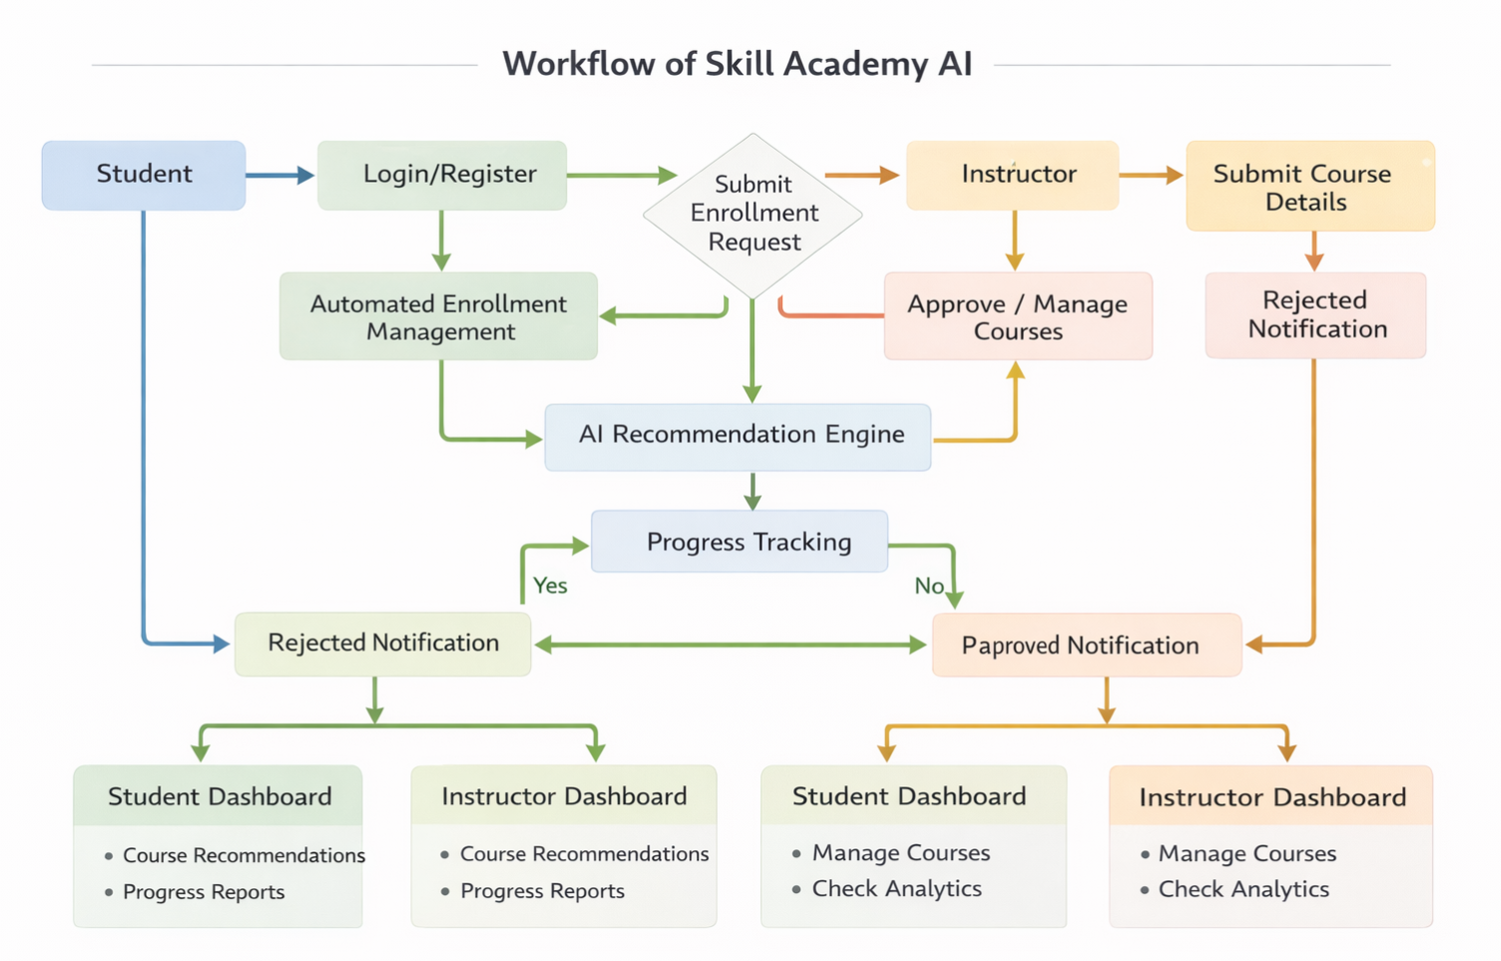
WORKFLOW
1
2
3
4
5
6
7
8
9

Slide 9
TECHNOLOGIES USED
1. Presentation Layer (Frontend)
HTML5 – Structure of web pages
CSS3 – Styling, layout, responsive UI
JavaScript – Client-side interactivity and validation
2. Application Layer (Backend)
PHP – Server-side scripting, session management, authentication, role-based access control, enrollment processing
3. Data Layer (Database)
MySQL – Stores users, courses, enrollments, and progress data
4. Development & Deployment Tools
XAMPP – Local server environment (Apache + MySQL)
phpMyAdmin – Database management
1
2
3
4
5
6
7
8
9

Slide 10
MODULE DESCRIPTION
Module 1: User Management
Handles user registration, secure login, and session management.
Implements role-based access control to differentiate students and instructors.
Ensures secure password handling and controlled system access.
Module 2: Core Processing
Handles user registration, secure login, and session management.
Implements role-based access control to differentiate students and instructors.
Ensures secure password handling and controlled system access.
1
2
3
4
5
6
7
8
9

Slide 11
MODULE DESCRIPTION
Module 3: Database Management
Enables students to submit enrollment requests for courses.
Allows instructors to approve or reject requests through a controlled workflow.
Maintains enrollment status and ensures structured access to courses.
Module 4: Reporting & Analytics
Tracks student learning progress and updates completion percentage.
Generates AI-based course recommendations based on user activity and preferences.
Provides analytical insights to enhance personalized learning experience.
1
2
3
4
5
6
7
8
9

Slide 12
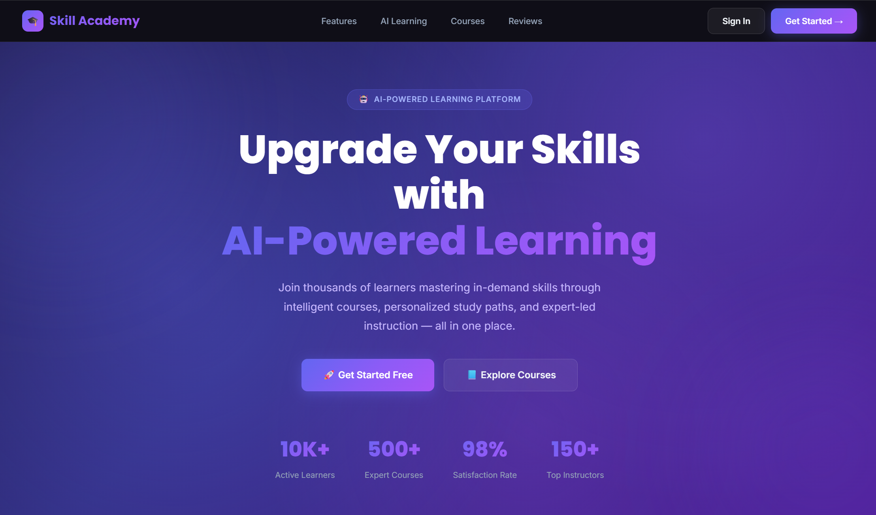
IMPLEMENTATION SCREENSHOTS
Home Page:
1
2
3
4
5
6
7
8
9
The Home Page provides an overview of the Skill Academy AI platform with navigation options for courses, login, and dashboard access. It serves as the primary entry point to the system.

Slide 13
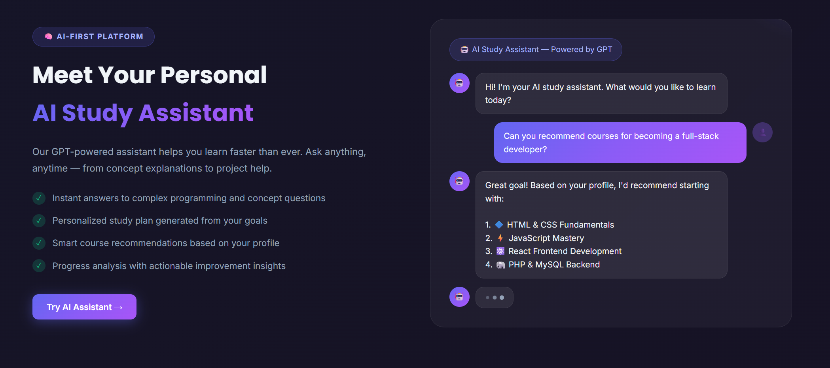
IMPLEMENTATION SCREENSHOTS
1
2
3
4
5
6
7
8
9

Slide 14
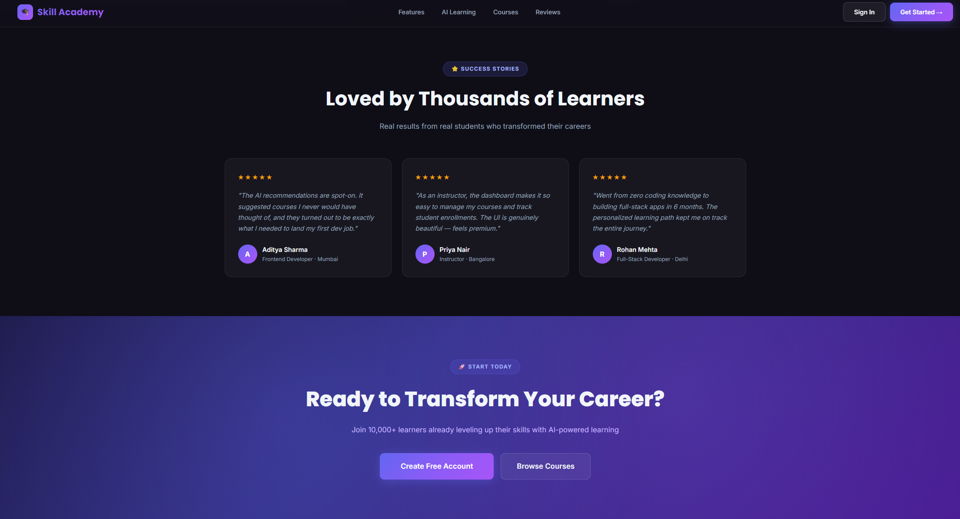
IMPLEMENTATION SCREENSHOTS
1
2
3
4
5
6
7
8
9

Slide 15
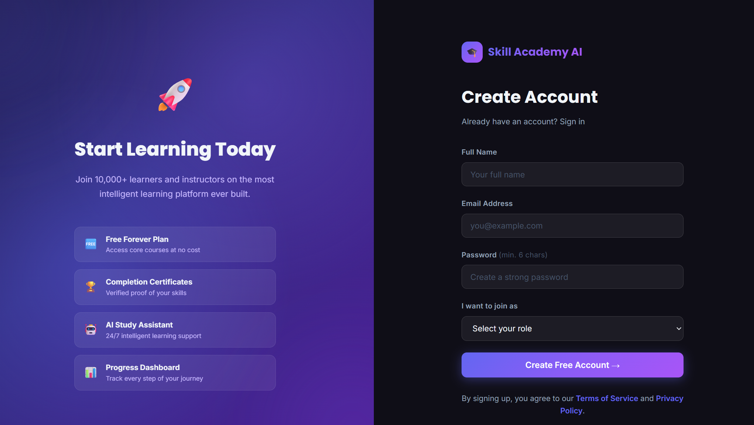
IMPLEMENTATION SCREENSHOTS
2. Sign-in Page :
1
2
3
4
5
6
7
8
9
The Sign-Up Page allows new users to create an account by selecting their role and providing required credentials. It securely stores user data in the database to enable authenticated access to the system.

Slide 16
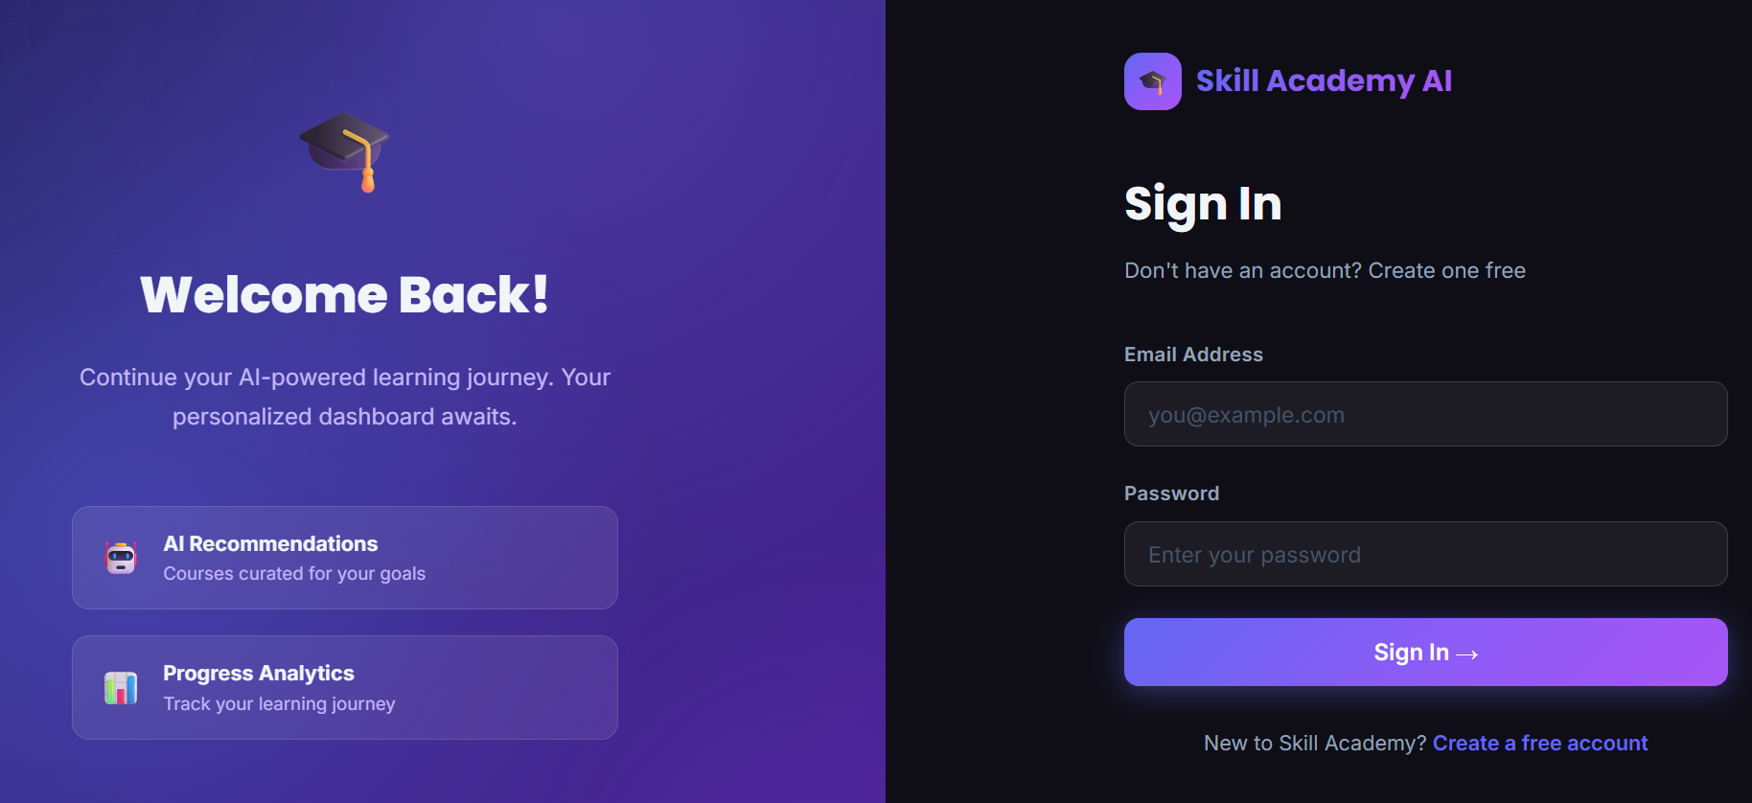
IMPLEMENTATION SCREENSHOTS
2. Login Page :
1
2
3
4
5
6
7
8
9
The Login Page implements secure authentication using role-based access control for students and instructors. It ensures controlled system access through session management.

Slide 17
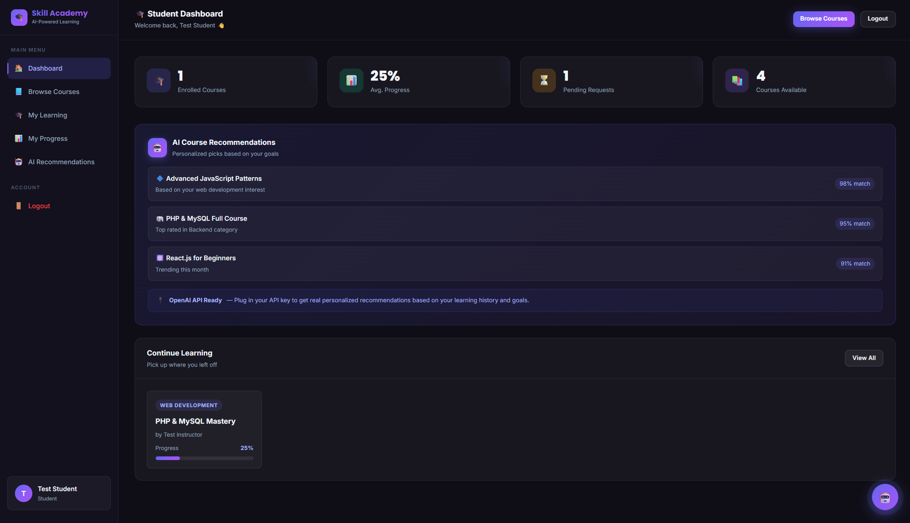
IMPLEMENTATION SCREENSHOTS
3. Student Dashboard :
1
2
3
4
5
6
7
8(A)
9
The Student Dashboard allows users to view available courses, request enrollments, track learning progress, and access AI-based course recommendations. It provides a personalized learning interface.

Slide 18
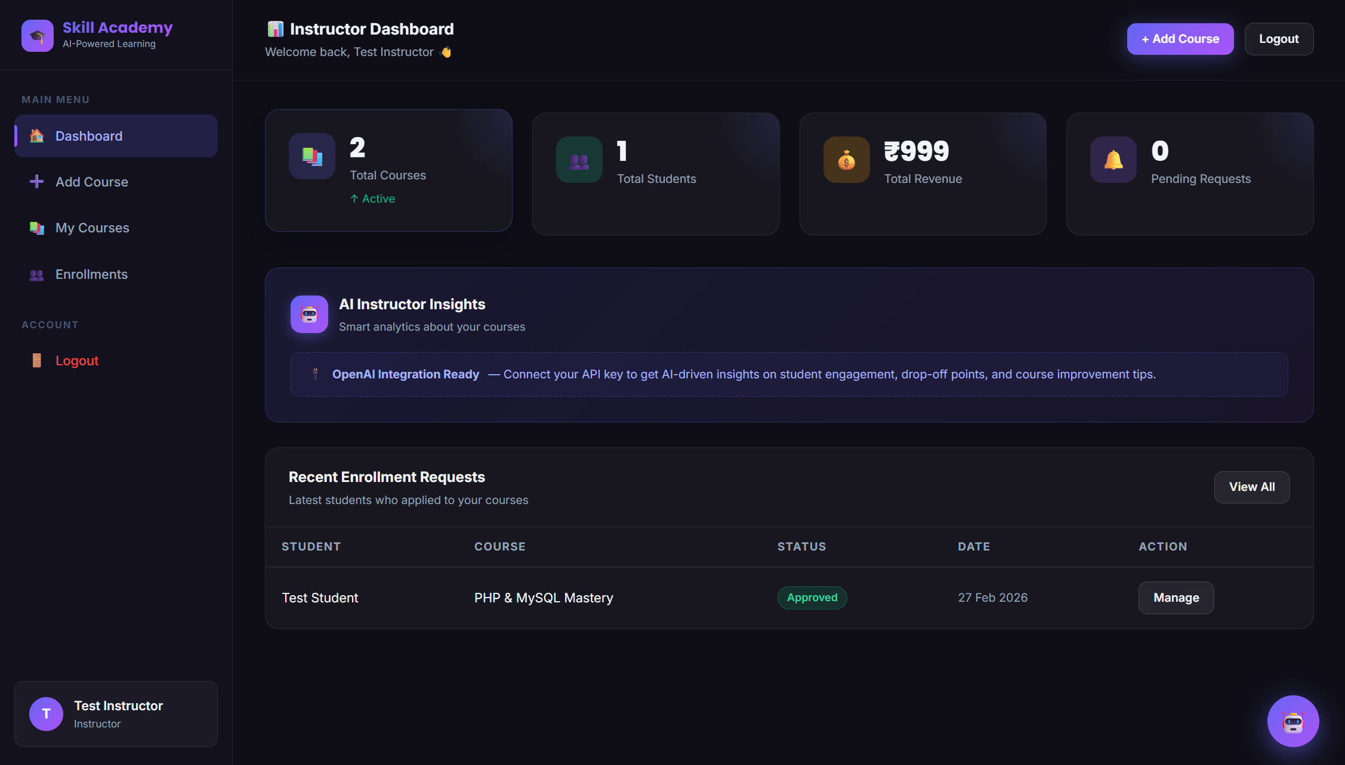
IMPLEMENTATION SCREENSHOTS
4. Instructor Dashboard :
1
2
3
4
5
6
7
8(B)
9
The Instructor Dashboard enables course creation, modification, and enrollment approval management. It also provides analytical insights for monitoring student participation and course performance.

Slide 19
ADVANTAGES & LIMITATIONS
ADVANTAGES:
• Provides secure role-based authentication for structured access control. • Automates course management and enrollment approval workflow. • Enhances learning experience through AI-based course recommendation features. • Enables real-time progress tracking for effective performance monitoring.
1
2
3
4
5
6
LIMITATIONS :
• The AI Study Assistant chat module is currently non-functional due to the absence of an API key for external AI service integration. • The system is deployed in a local environment and is not yet hosted on a cloud server. • Advanced analytics and full AI model integration are limited to prototype-level implementation.
7
8
9

Slide 20
Thank you

